Slide 1

PursePro
Done by : Muhammad Bilal
Rana Bilal
Mehboob Ali

Slide 2
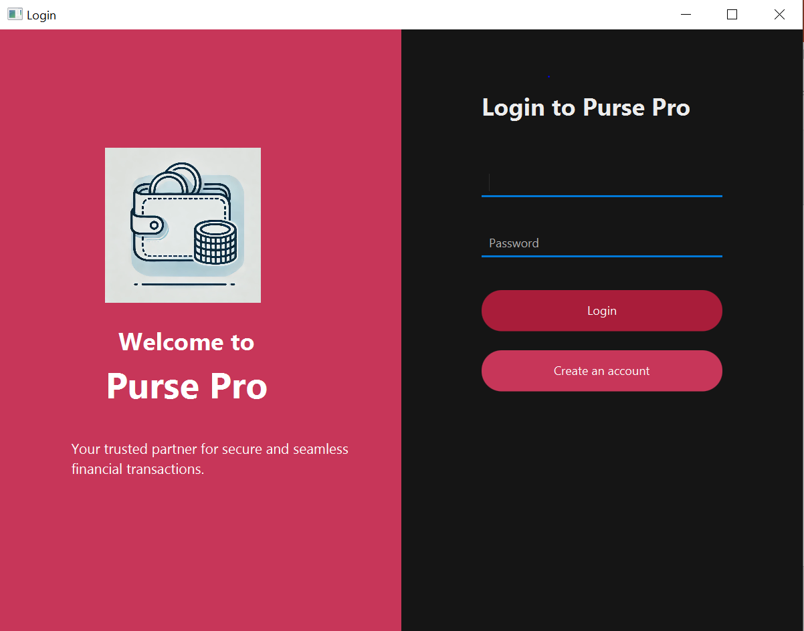

Slide 3
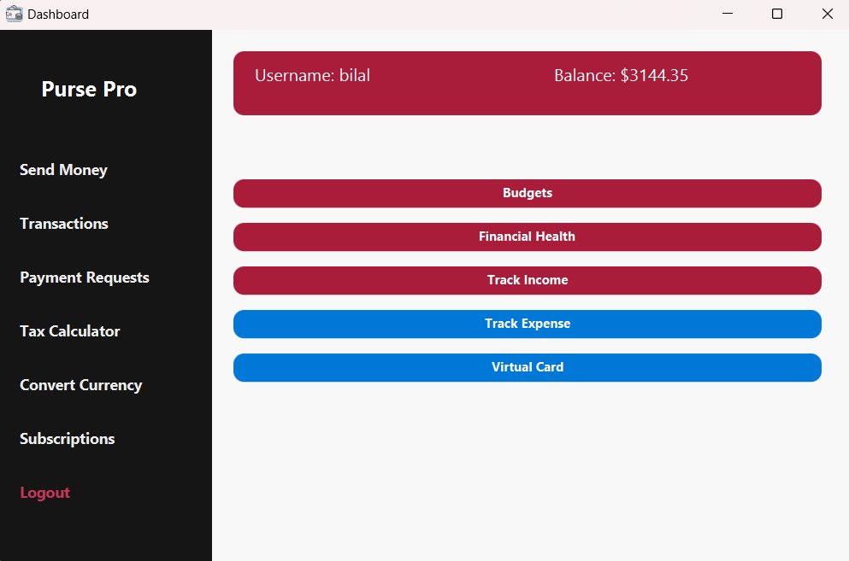

Slide 4
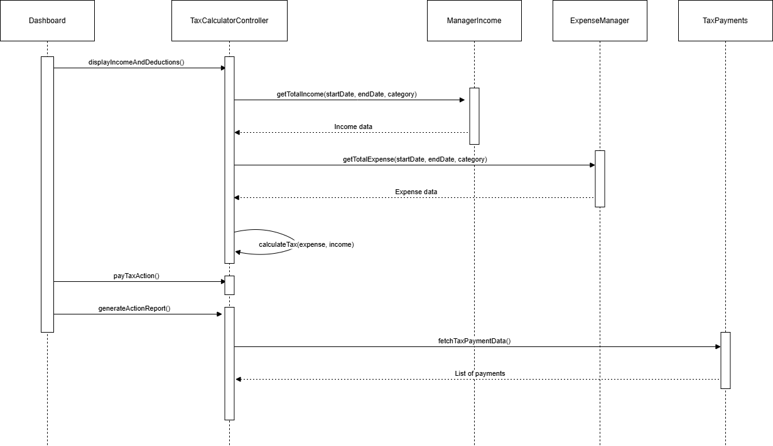
SD

Slide 5
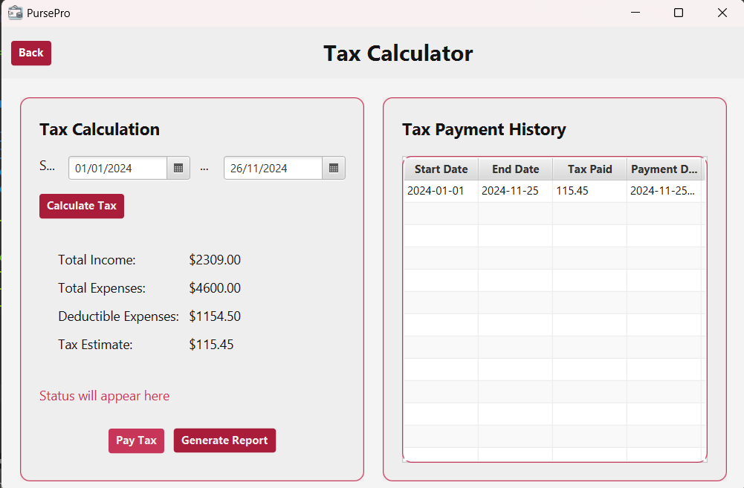

Slide 6
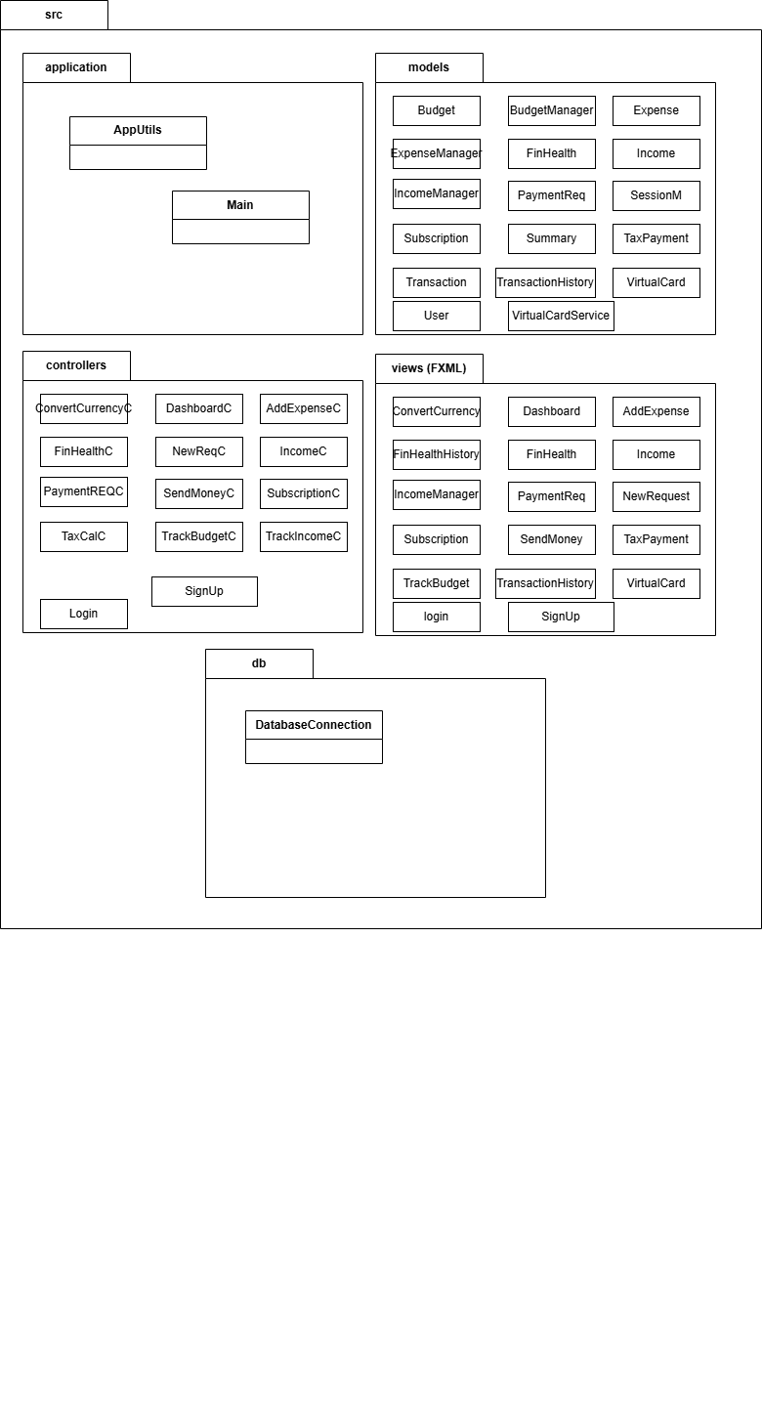
Package Diagram

Slide 7
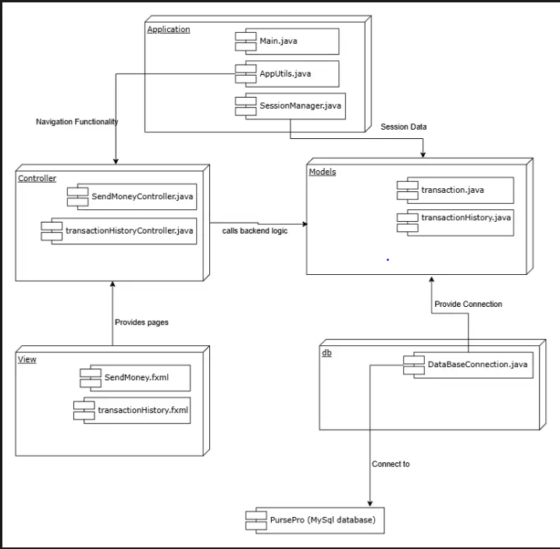
Component Diagram

Slide 8
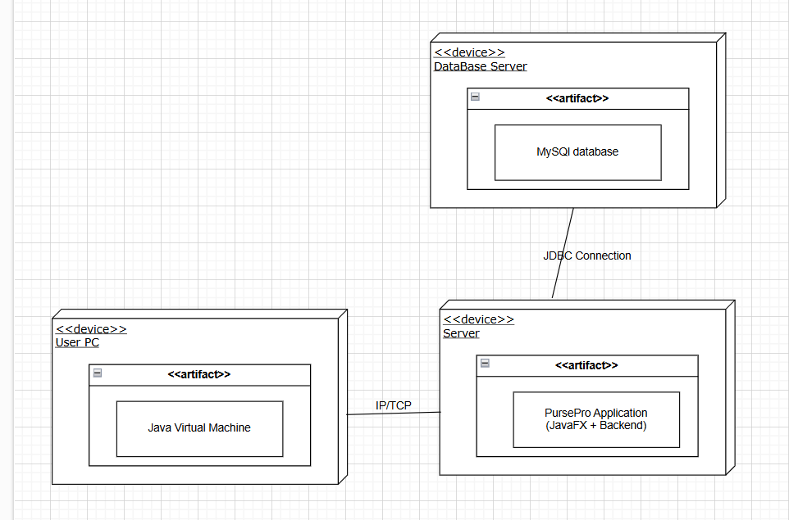
Deployment Diagram

Slide 9
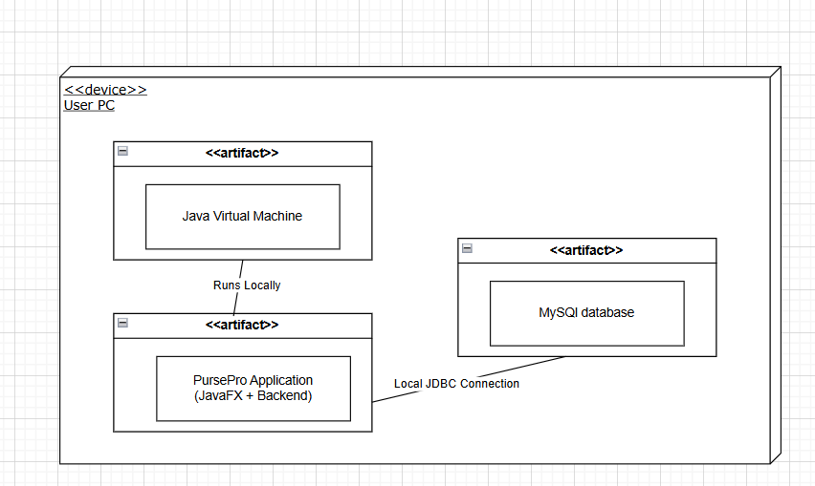
Deployment Diagram

Slide 10
Design Pattern
Singleton -> SessionManager, ExpenseManager
Controller-> TrackExpenseController, FinancialHealthCalculator
InformationExpert->
i) Expense(insertToDatabase) , ii)IncomeManager(calculateTotalIncome)
4) PureFabrication-> Budget Manager, IncomeManager

